Slide 1

Chapter 2 ~ Spatial and Intensity Resolution
Heaven’s Light is Our Guide
Department of Computer Science & Engineering
Rajshahi University of Engineering & Technology, Rajshahi-6204, Bangladesh.
S. M. Mahedy Hasan
Assistant Professor, Dept. of CSE
RUET, Rajshahi-6204, Bangladesh.

Slide 2
Image Sampling and Quantization
Image sampling involves taking the value of the image at regular spatial intervals. The length of the intervals defines the spatial resolution of the image.
If we increase the number of pixels in the image, we can better represent an analog object into a digital image.
Image quantization involves discretizing the intensity values of the analog image.
If we increase the number of discrete values representing the image intensity values in the image, the better we can represent an analog object into a digital image.

Slide 3
Image Sampling and Quantization
Widely used definition of image resolution is the largest number of discernible line pairs per unit distance.
In the printing and publishing industry, dots per unit distance is a measure of image resolution used.
Example: In the U.S., this measure usually is expressed as dots per inch(dpi).
Sampling is the principle factor determining the spatial resolution of an image.

Slide 4
Spatial Resolution
Intuitively, spatial resolution is a measure of the smallest discernible detail in an image.
Quantitatively, spatial resolution can be stated in a number of ways, with line pairs per unit distance, and dots (pixels) per unit distance being among the most common measures.

Slide 5
Intensity Resolution
Intensity (Gray-Level) resolution similarly refers to the smallest discernible change in intensity level.
It is common practice to refer to the number of bits used to quantize intensity as the intensity resolution
For example, it is common to say that an image whose intensity is quantized into 256 levels has 8 bits of intensity resolution.

Slide 6
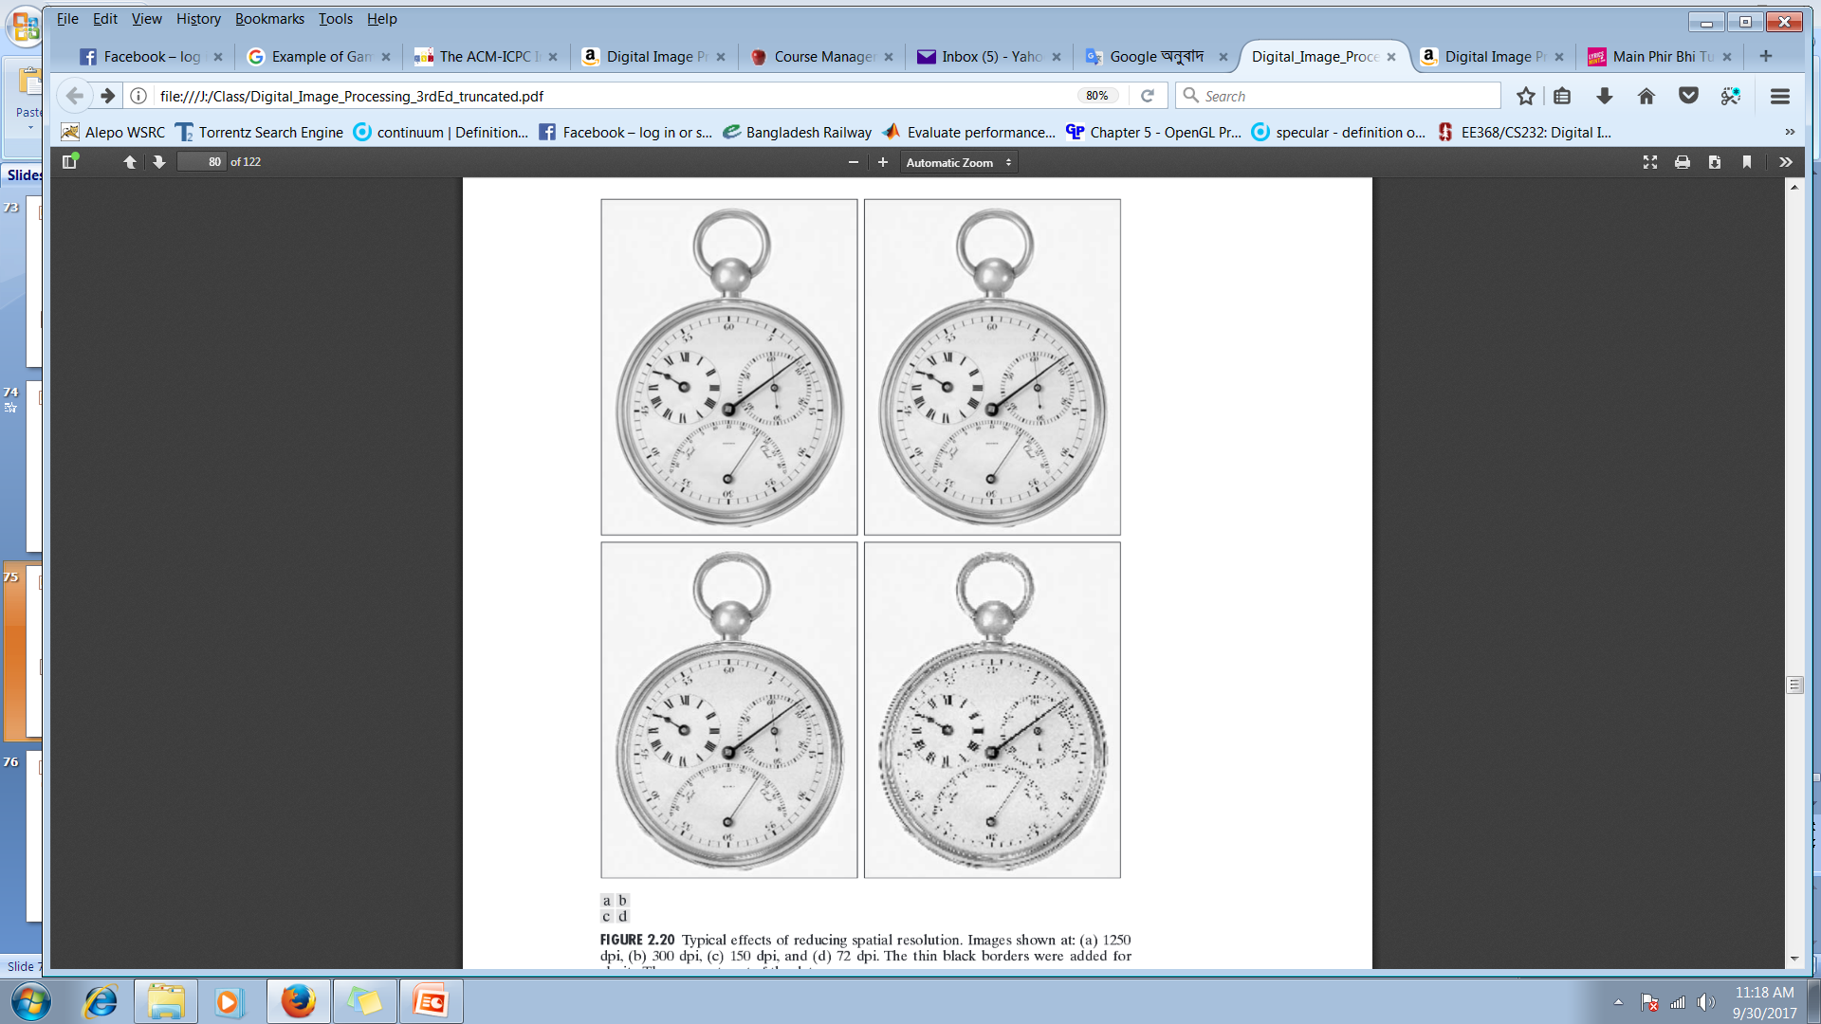
Illustration of the effects of reducing image spatial resolution
Figure shows the effects of reducing spatial resolution in an image.
The images in Figs. (a) through (d) are shown in 1250, 300, 150, and 72 dpi, respectively.
Naturally, the lower resolution images are smaller than the original.
For example, the original image is of size 3692 X 2812 pixels, but the 72 dpi image is an array of size 213 X 162 pixels.
It is possible to improve on the results of Fig. (d) by the choice of interpolation method used.

Slide 7
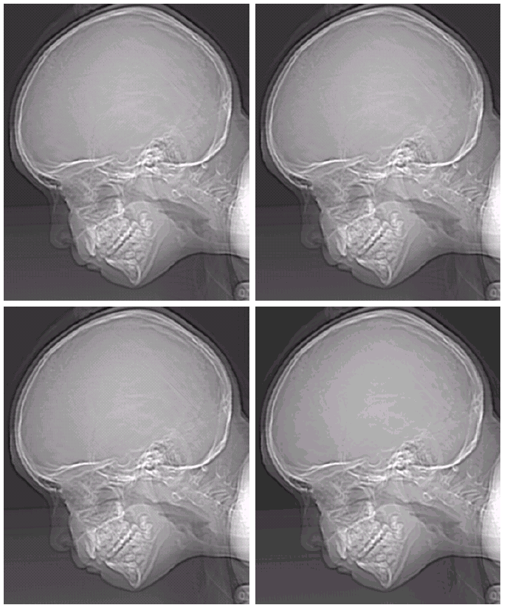
Typical effects of varying the number of intensity levels in a digital image
In this example, we keep the number of samples constant and reduce the number of intensity levels from 256 to 32, in integer powers of 2.
Here, all the images are in size of 452 X 374 pixels.
256
128
64
32

Slide 8
Typical effects of varying the number of intensity levels in a digital image
The 32-level image, however, has an imperceptible set of very fine ridge-like structures in areas of constant or nearly constant intensity (particularly in the skull). This effect, caused by the use of an insufficient number of intensity levels in smooth areas of a digital image, is called false contouring.
256
128
64
32

Slide 9
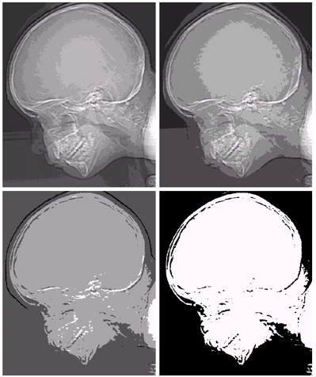
Typical effects of varying the number of intensity levels in a digital image
16
8
4
2

Slide 10
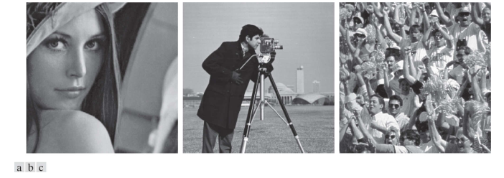
Spatial and Intensity Resolution
Huang [1965] attempted to quantify experimentally the effects on image quality produced by varying N and k simultaneously.
Dataset
Figure 1: (a) Image with a low level of detail. (b) Image with a medium level of detail. (c) Image with a relatively large amount of detail

Slide 11
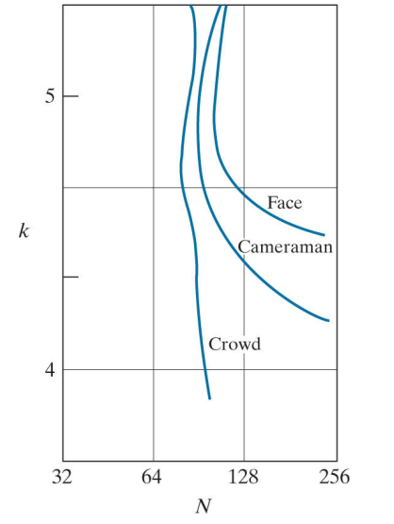
Spatial and Intensity Resolution
Sets of these three types of images were generated by varying N and k, and observers were then asked to rank them according to their subjective quality.
Results were summarized in the form of so-called iso-preference curves in the NK-plane.
The key point of interest in the context of the present discussion is that iso-preference curves tend to become more vertical as the detail in the image increases.
Images with a large amount of detail only a few intensity levels may be needed.
Larger values for N and k, which implies better picture quality……

Slide 12
Image Interpolation
Zooming, shrinking, rotating, and geometric corrections.
Interpolation is the process of using known data to estimate values at unknown locations.
Nearest Neighbor Interpolation
Bilinear Interpolation
Bicubic Interpolation
Bicubic interpolation is the standard used in commercial image editing programs, such as Adobe Photoshop and Corel Photo paint.
Notes:
Help Link: http://users.wfu.edu/matthews/misc/DigPhotog/alias/

Slide 13
Nearest Neighbor Interpolation
?
1 | 4 | 7
2 | 5 | 8
3 | 6 | 9
Nearest Neighbor
× 3
Notes:
Help Link: http://users.wfu.edu/matthews/misc/DigPhotog/alias/

Slide 14
Nearest Neighbor Interpolation
1 |  |  | 4 |  |  | 7
2 |  |  | 5 |  |  | 8
3 |  |  | 6 |  |  | 9
1 | 4 | 7
2 | 5 | 8
3 | 6 | 9
Nearest Neighbor
× 3
Notes:
Help Link: http://users.wfu.edu/matthews/misc/DigPhotog/alias/

Slide 15
Nearest Neighbor Interpolation
1 |  |  | 4 |  |  | 7
1 |  |  | 4 |  |  | 7
1 |  |  | 4 |  |  | 7
2 |  |  | 5 |  |  | 8
2 |  |  | 5 |  |  | 8
2 |  |  | 5 |  |  | 8
3 |  |  | 6 |  |  | 9
3 |  |  | 6 |  |  | 9
3 |  |  | 6 |  |  | 9
1 | 4 | 7
2 | 5 | 8
3 | 6 | 9
Nearest Neighbor
× 3
Notes:
Help Link: http://users.wfu.edu/matthews/misc/DigPhotog/alias/

Slide 16
Nearest Neighbor Interpolation
1 | 1 | 1 | 4 | 4 | 4 | 7 | 7 | 7
1 | 1 | 1 | 4 | 4 | 4 | 7 | 7 | 7
1 | 1 | 1 | 4 | 4 | 4 | 7 | 7 | 7
2 | 2 | 2 | 5 | 5 | 5 | 8 | 8 | 8
2 | 2 | 2 | 5 | 5 | 5 | 8 | 8 | 8
2 | 2 | 2 | 5 | 5 | 5 | 8 | 8 | 8
3 | 3 | 3 | 6 | 6 | 6 | 9 | 9 | 9
3 | 3 | 3 | 6 | 6 | 6 | 9 | 9 | 9
3 | 3 | 3 | 6 | 6 | 6 | 9 | 9 | 9
1 | 4 | 7
2 | 5 | 8
3 | 6 | 9
Nearest Neighbor
× 3
Notes:
Help Link: http://users.wfu.edu/matthews/misc/DigPhotog/alias/

Slide 17
Nearest Neighbor Interpolation
Nearest Neighbor
× 3
Notes:
Help Link: http://users.wfu.edu/matthews/misc/DigPhotog/alias/

Slide 18
Bilinear Interpolation
I = | 1 | 2
 | 3 | 4
>> imresize(I,2,'bilinear')
I = | 1.00 | 1.25 | 1.75 | 2.00
 | 1.50 | 1.75 | 2.25 | 2.50
 | 2.50 | 2.75 | 3.25 | 3.50
 | 3.00 | 3.25 | 3.75 | 4.00
I = | 1.00 |  |  | 2.00
 | 3.00 |  |  | 4.00
Notes:
Help Link: http://users.wfu.edu/matthews/misc/DigPhotog/alias/

Slide 19
Bilinear Interpolation
I = | 1 | 2
 | 3 | 4
>> imresize(I,2,'bilinear')
I = | 1.00 | 1.25 | 1.75 | 2.00
 | 1.50 | 1.75 | 2.25 | 2.50
 | 2.50 | 2.75 | 3.25 | 3.50
 | 3.00 | 3.25 | 3.75 | 4.00
I = | 1.00 | 1.25 |  | 2.00
 | 3.00 |  |  | 4.00
Notes:
Help Link: http://users.wfu.edu/matthews/misc/DigPhotog/alias/

Slide 20
Bilinear Interpolation
I = | 1 | 2
 | 3 | 4
>> imresize(I,2,'bilinear')
I = | 1.00 | 1.25 | 1.75 | 2.00
 | 1.50 | 1.75 | 2.25 | 2.50
 | 2.50 | 2.75 | 3.25 | 3.50
 | 3.00 | 3.25 | 3.75 | 4.00
I = | 1.00 | 1.25 |  | 2.00
 | 3.00 | 3.25 |  | 4.00
Notes:
Help Link: http://users.wfu.edu/matthews/misc/DigPhotog/alias/

Slide 21
Bilinear Interpolation
I = | 1 | 2
 | 3 | 4
>> imresize(I,2,'bilinear')
I = | 1.00 | 1.25 | 1.75 | 2.00
 | 1.50 | 1.75 | 2.25 | 2.50
 | 2.50 | 2.75 | 3.25 | 3.50
 | 3.00 | 3.25 | 3.75 | 4.00
I = | 1.00 | 1.25 | ? | 2.00
 | ? | 1.75 | ? | ?
 | ? | ? | ? | ?
 | 3.00 | 3.25 | ? | 4.00
Notes:
Help Link: http://users.wfu.edu/matthews/misc/DigPhotog/alias/

Slide 22
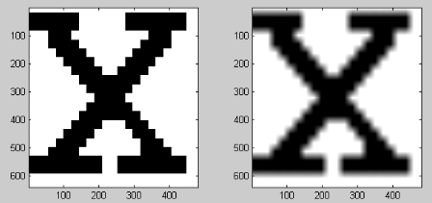

Zooming in Interpolation
Original image
Nearest Neighbor
Bi-Linear
Notes:
Help Link: http://users.wfu.edu/matthews/misc/DigPhotog/alias/

Slide 23
Bicubic interpolation
Self Study!!!
Notes:
Help Link: http://users.wfu.edu/matthews/misc/DigPhotog/alias/

Slide 24
Thank You ☺

